Slide 1
West African Life

Slide 2
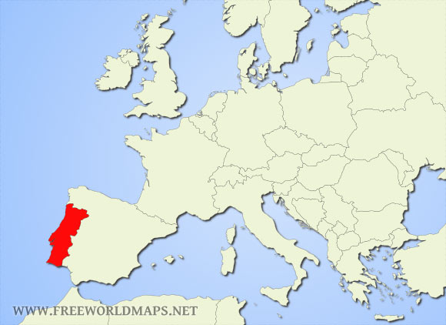
Portuguese
Prince Henry the Navigator -1419 began to charter ships to sail into the Atlantic looking for Gold, Ivory and slaves
Started as pirates looting
Gulf of Guinea
met enough resistance forcing Portugal to trade

Slide 3
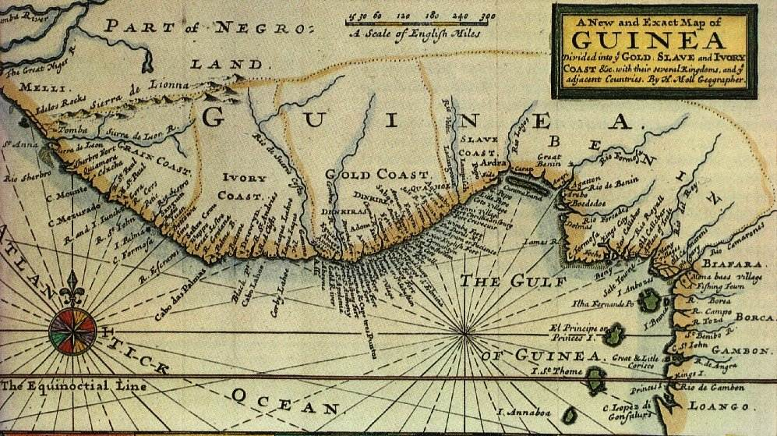

Slide 4
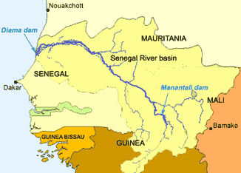
West Africa
Sahara-Massive Desert
Savannah-Lush Grasslands
Niger, Senegal- Major rivers

Slide 5
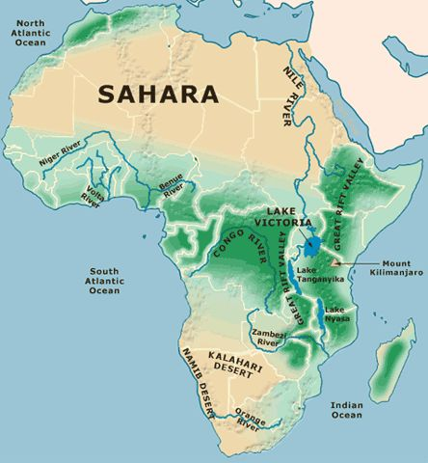

Slide 6
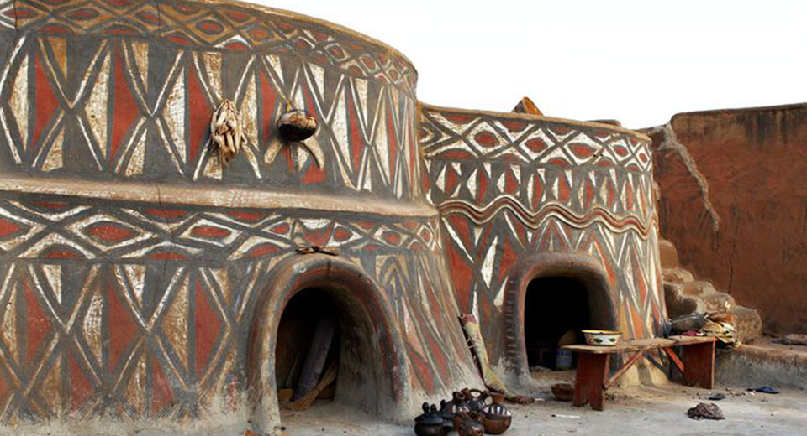
Ghana
Ghana- 300-1500 ACE. Lived from the Atlantic Ocean to The Niger River
Large city with extensive trade
Provided the Mediterranean with most of its gold
Large Muslim influence through Morocco

Slide 7
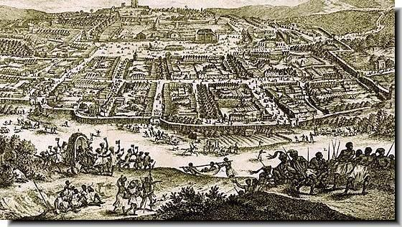

Slide 8
Supplanted By Mali
Weakened by outside attacks Ghana loses control of the trade network
New Kingdom of Mali gains control
King Mansa Musa Expands Mali and introduces Islam
Islamic influence allows for the construction of a famous university to be created in Timbuktu

Slide 9
Songhai Take over
Led by Askia Muhammad their peoples flourished in trade and conquered the Mali kingdom
Became the most powerful and largest kingdom in west Africa
Furthered Islamic influence sustaining Islamic education in Timbuktu

Slide 10
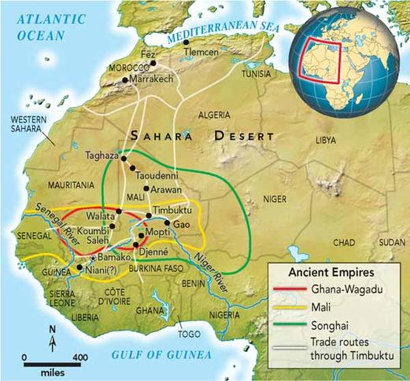

Slide 11
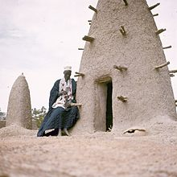
West African Life
Traditional Beliefs:
Great Creator with many Spiritual beings that inhabited every object and creature
Spirits live in Rain, rocks, trees, animals, ancestors also very influential
Islam also traveled along the caravan routes in large numbers

Slide 12
Economy and Society
Land not owned by individuals as private property
People worked land with rights from ancient ancestors
Powerful Kings appointed officials to collect tribute from specific regions
People worked collectively and split the harvest
Wealth was based on # of slaves or wives one had

Slide 13
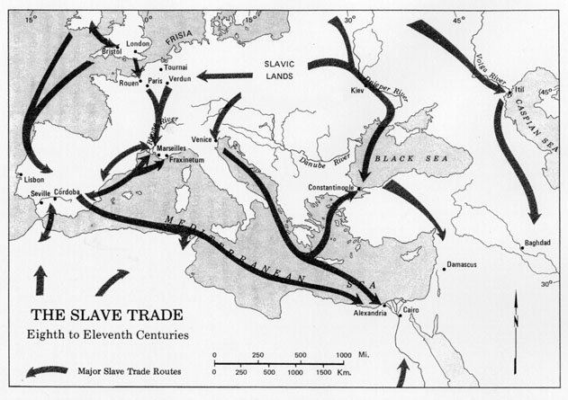
Slavery in West Africa
Slavery was common in West Africa
West African rulers sold about 1,000 Slaves to Arab traders per Year
Captured, Conquered, Criminals, or otherwise undesired peoples were enslaved

Slide 14
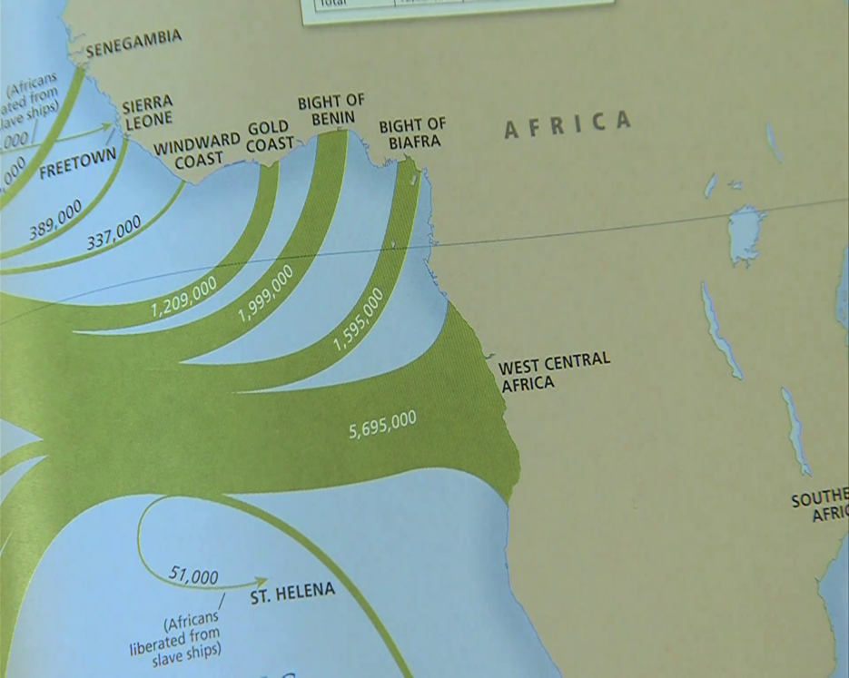
Unlike Slavery in the Americas
Slaves were adopted into families and allowed to marry
Their children were not born slaves
Kings relied on slave armies
Some slave officials became wealthy
Slavery was not based on racial superiority

