Slide 1
Three Worlds Meet
Unit 1

Slide 2
Peopling the Americas
Roughly 40,000 years ago
Beringia Land Bridge- allowed nomadic Peoples to travel into North America
End of the Ice Age covered the land bridge.
Hunting and Gathering- Hunters shifted from Big-Game to small-game hunting and gathering

Slide 3
Agriculture
Between 10,000 and 5,000 years ago
Peoples in now Central Mexico began to raise Maize (corn), gourds, pumpkin, peppers, beans.
People could remain in one place
Surplus
Extra time
Larger more stable, complex cultures

Slide 4
Complex Societies Flourish
Middle and South America
Olmec- First empire Southern Mexico ~1200 BCE
Maya- Guatemala Yucatan Peninsula 250-900 ACE
Aztec- Mexico 1200’s
Inca- South America 1400’s, 2,500 mile long mountainous western coast

Slide 5
Ancient Desert Farmers
Hohokam- Central Arizona
Anasazi- Four Corners
300 BCE-1200 ACE
Corn, Beans, Squash,

Slide 6
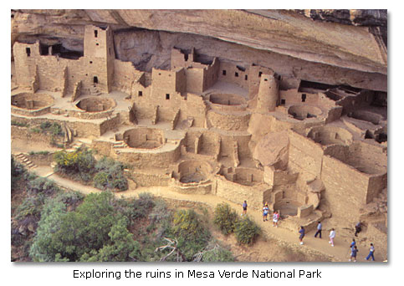
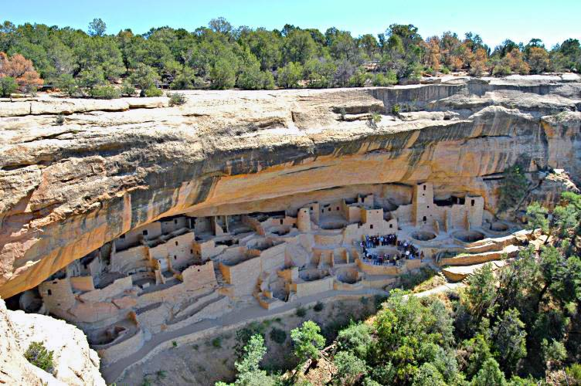

Slide 7
Mound Builders 800 BC-1500 AD
Adena, Hopewell, Mississippian
Substantial traders
Massive earthen structures
Burial mounds
Mounds shaped like animals
Gigantic pyramids

Slide 8
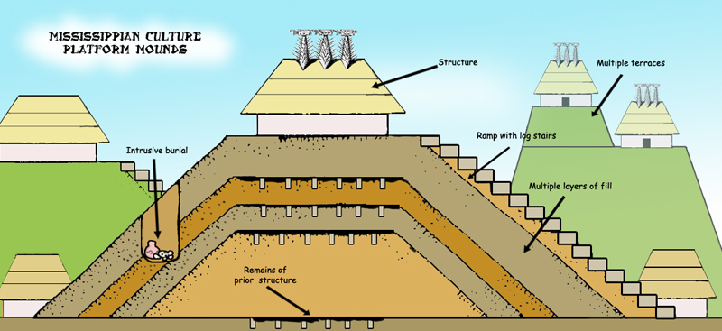

Slide 9
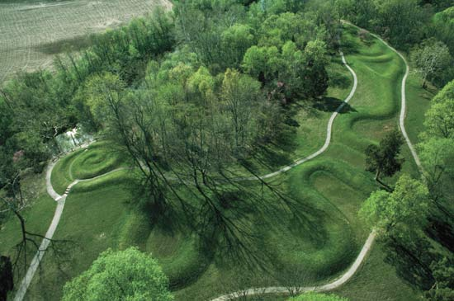

Slide 10
Native American Societies Around 1492
California-Kashaya Pomo
Northwest coast-Kwakiutl
Southwest-Pueblo
Eastern Woodlands- Iroquois

Slide 11
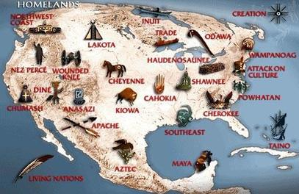
Shared Native American Cultural Patterns
Trading Networks connected peoples
Use of Land-
Could not be traded
Source of life
Not a commodity
Religious Belief-
Filled with spirits
Animism
All objects both living and non-living have a voice
Social Organization-
Kinship- Organized in clans or tribes
Division of labor- Assignment of jobs based on gender, age, or status

Slide 12
West Africa

