Slide 1
Lesson # 1 9.1.01: Students will define history and related concepts, cause/effect, time continuity and perspective. 9.1.03: Students will relate other social studies disciplines such as archeology and anthropology to the study of history. 9.1.04: Students will be able to define the themes of society, technology, economics, politics, and culture and relate them to the study of history.

Slide 2
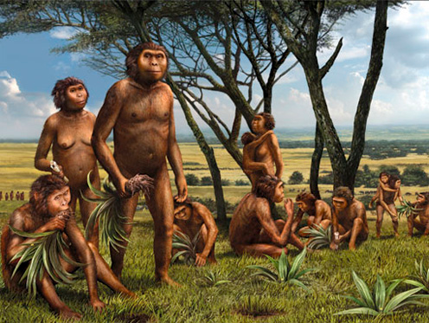
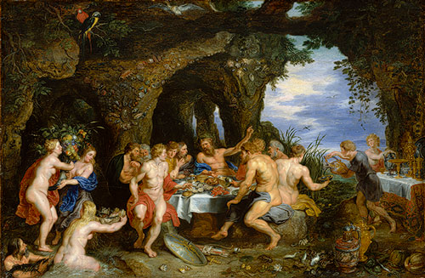
Understanding Our Past
https://www.youtube.com/watch?feature=player_detailpage&v=Mm-IxK1GrYE
Early Hominids
~7 Million B.C.E
Modern Homo sapiens
~3,200 B.C.E

Slide 3
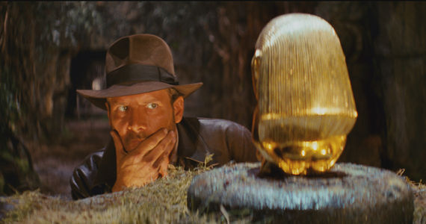
Writing to learn
What is the author telling us?

Slide 4
Be thinking about...
Q- Which of these species lived on earth at the same time?
Q- Why/what were the changes in skull and body shape?
Q-Make inferences upon the benefits of walking on two legs?
Q-Make observations on how these species are similar or different from each other?
Q-Analyze the differences and similarities between the early hominids and modern humans.

Slide 5
Blow it up!
Choose one of your ideas and expand on it with Four more sentences.

Slide 6
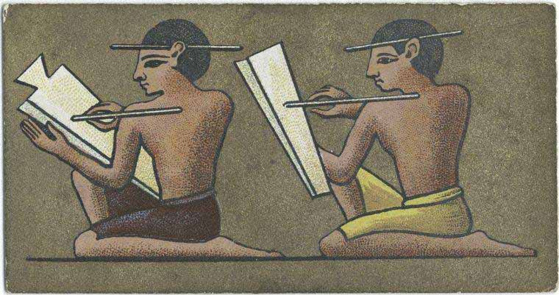
Our Word Wall
Hominid
Prehistory
Archaeology
Anthropology
Artifacts/fossils
Paleolithic“Old stone age”
Neolithic“New stone age”
Agriculture

Slide 7
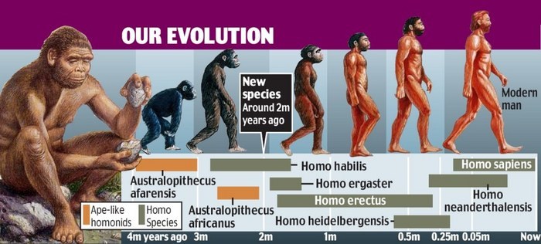

Slide 8
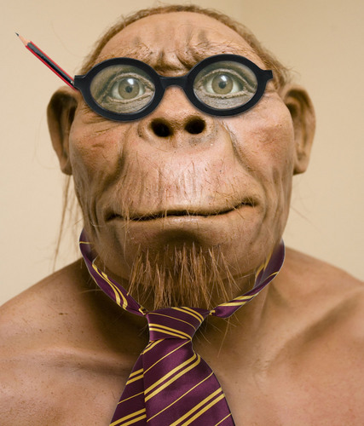
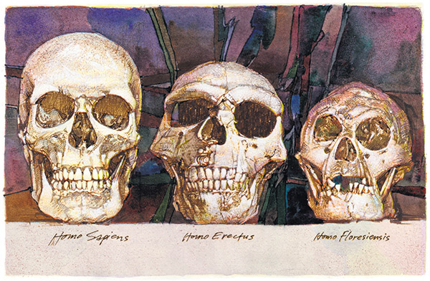
Hominids: A primate of a family (Hominidae) that includes humans and their fossil ancestors.

Slide 9
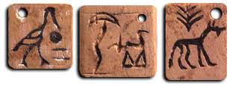
Prehistory: The vast period of time before people developed a system of written language.
Writing emerged ~3200 B.C.E.(Before the Common Era)

Slide 10
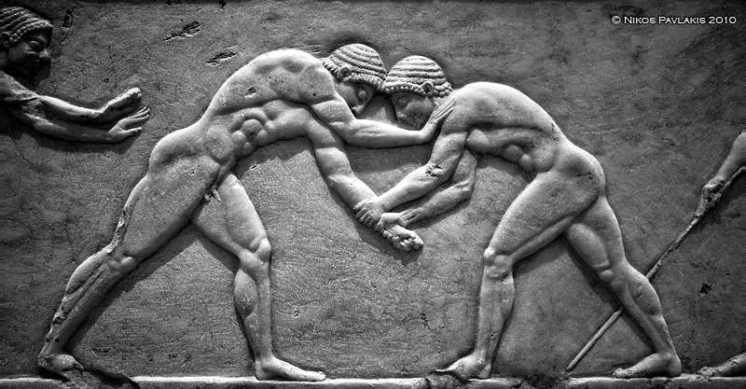
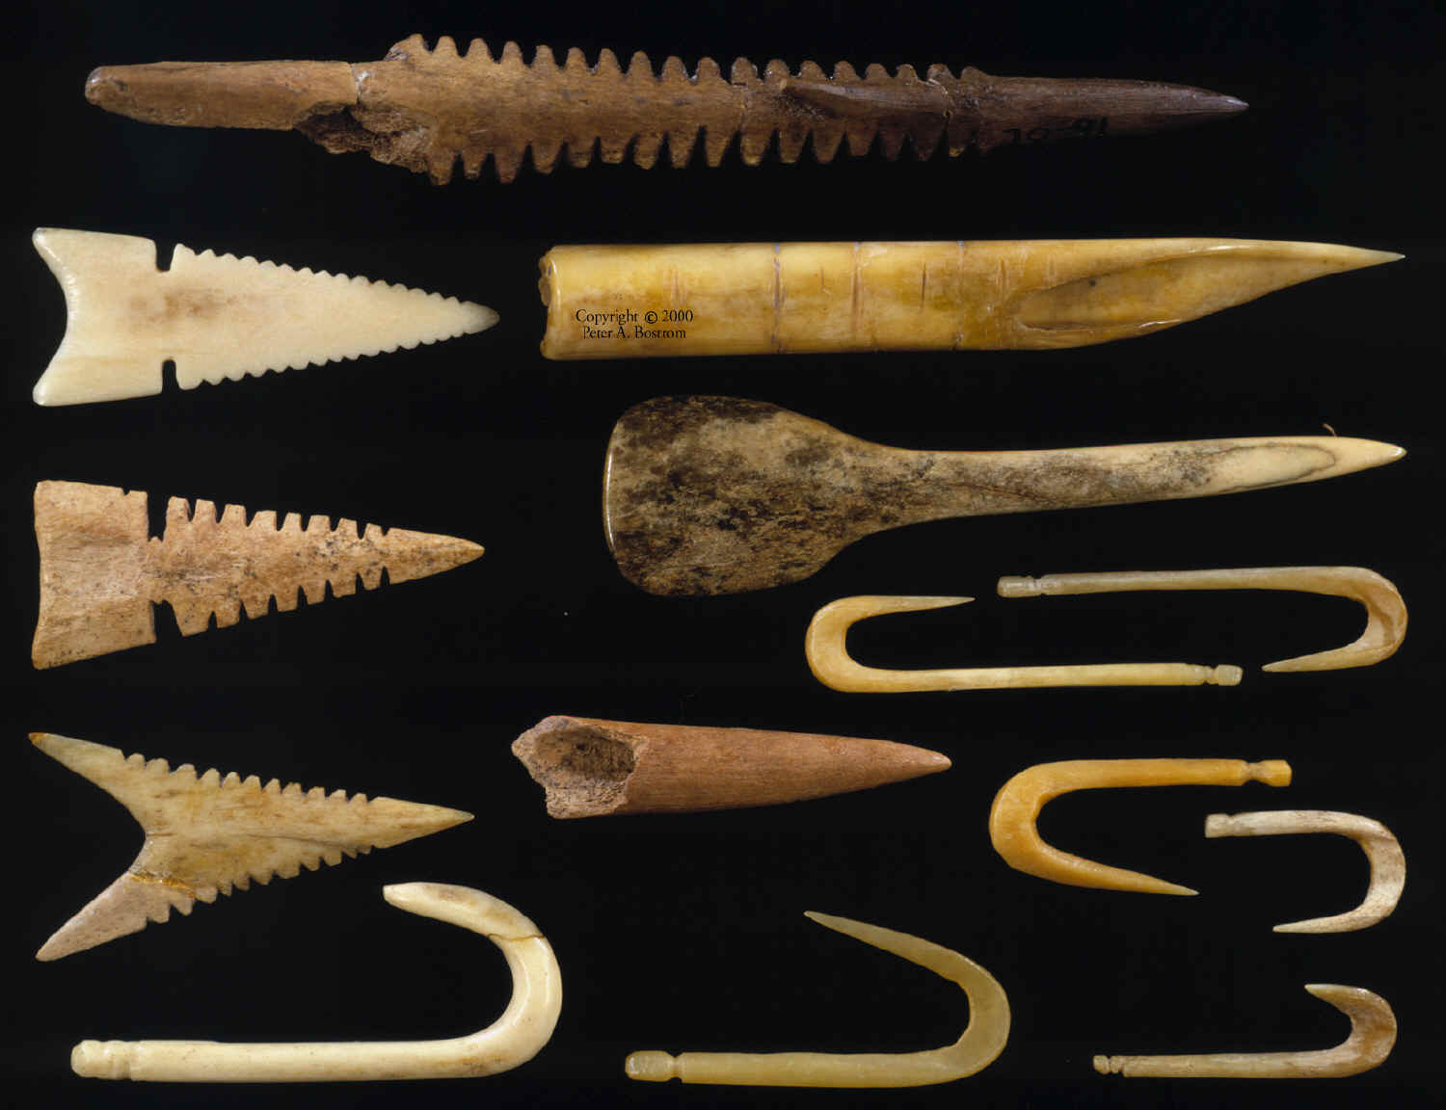
Anthropology:
The scientific study of human races, origins, societies, and cultural practices.
Archaeology:
The scientific study of material remains, artifacts of past human life and activities.

Slide 11
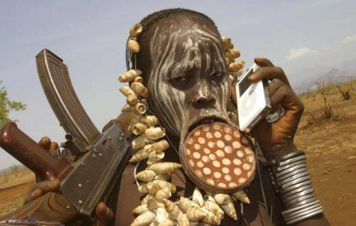
Anthropology or Archeology?

Slide 12
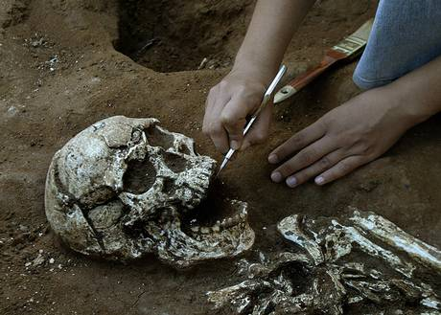

Slide 13
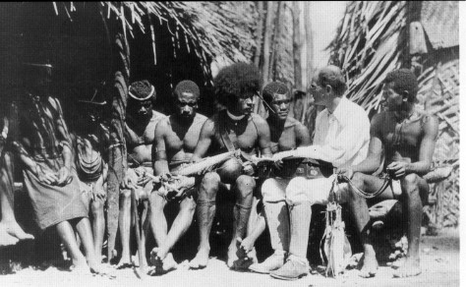

Slide 14
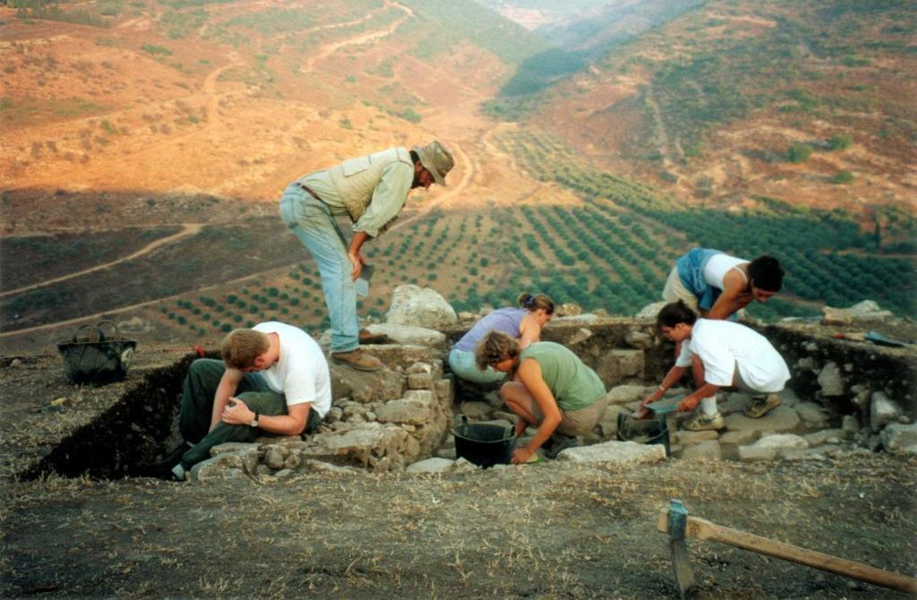

Slide 15
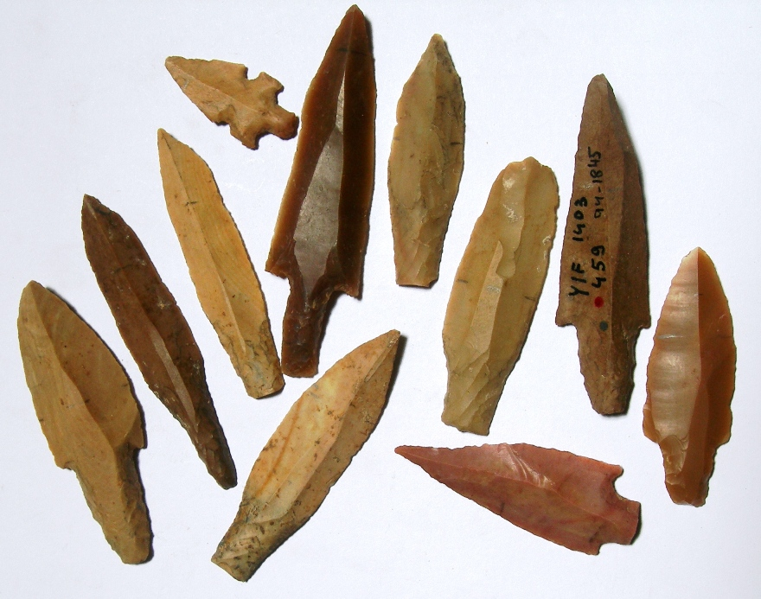
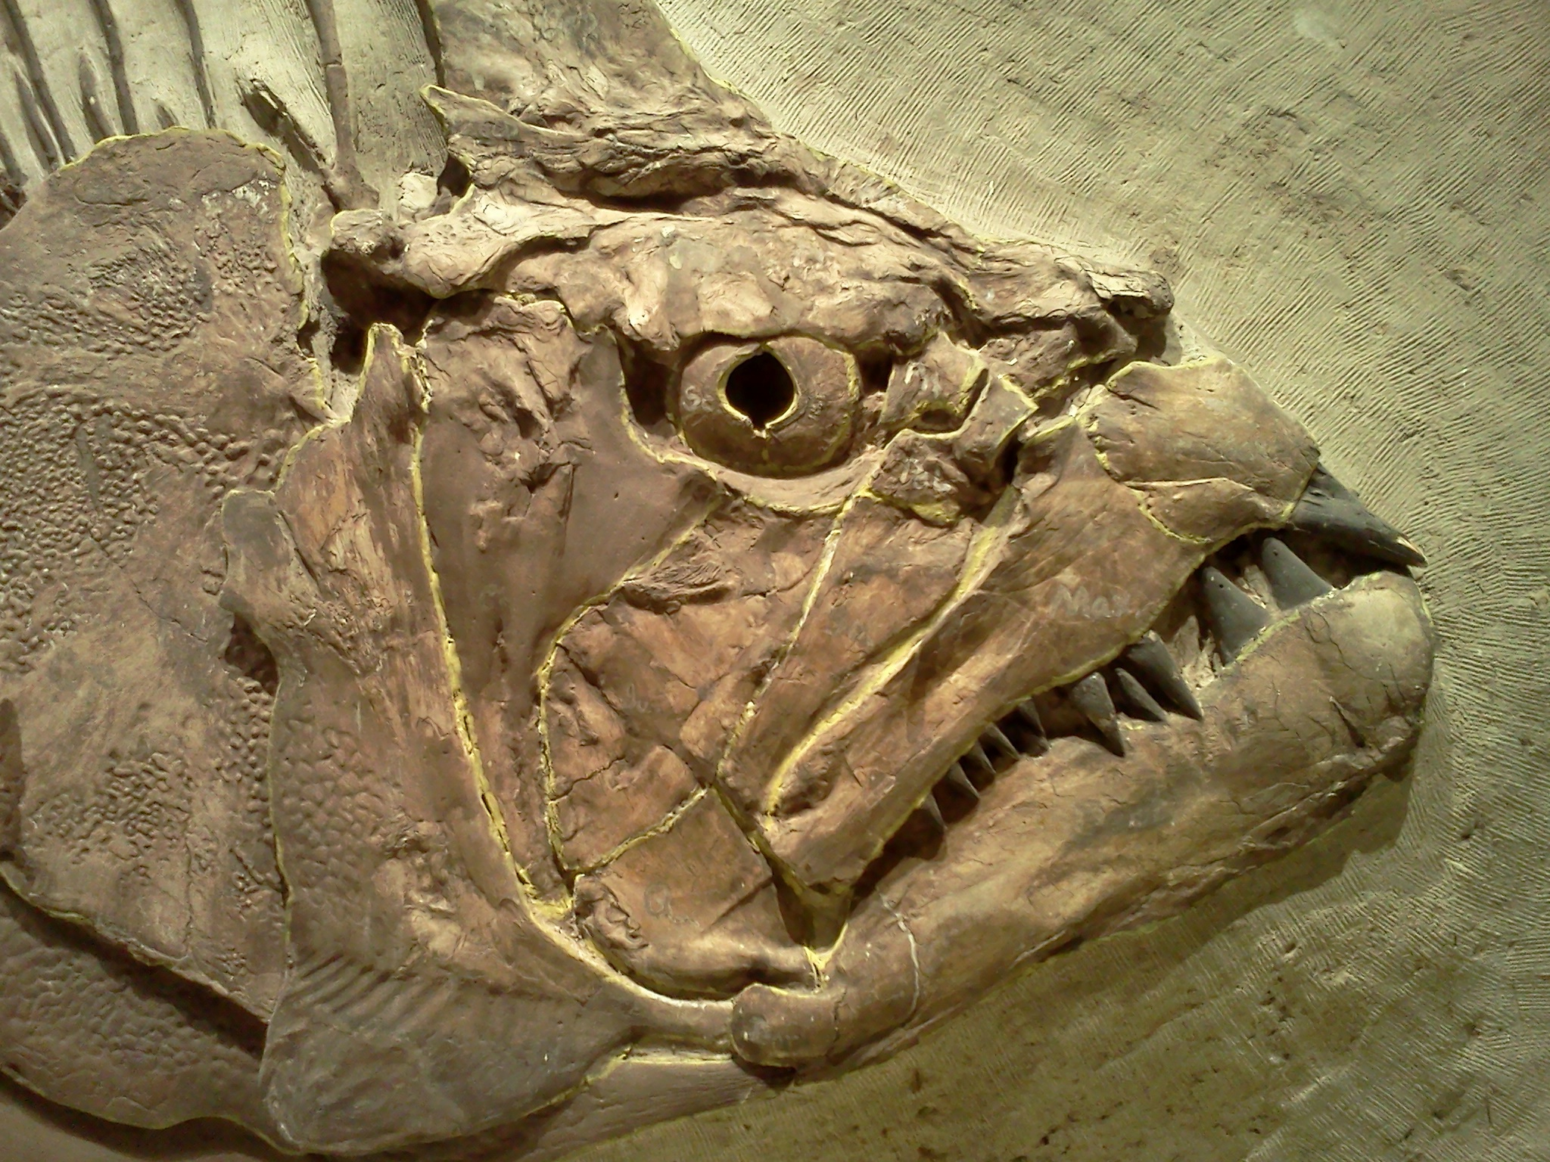
Artifacts: The remains of things that were made.
Fossils: The remains of living things.

Slide 16
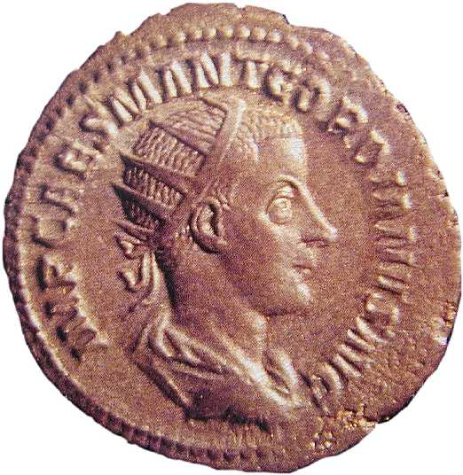
Artifact Or Fossil?

Slide 17
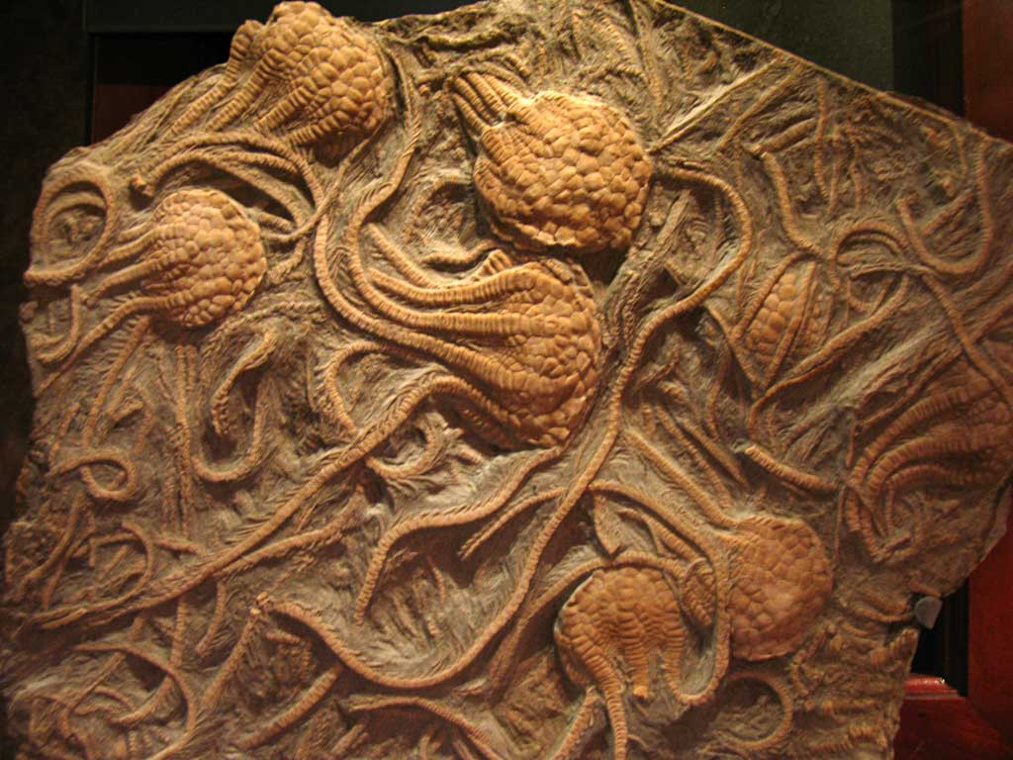

Slide 18
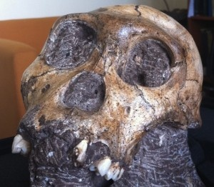

Slide 19
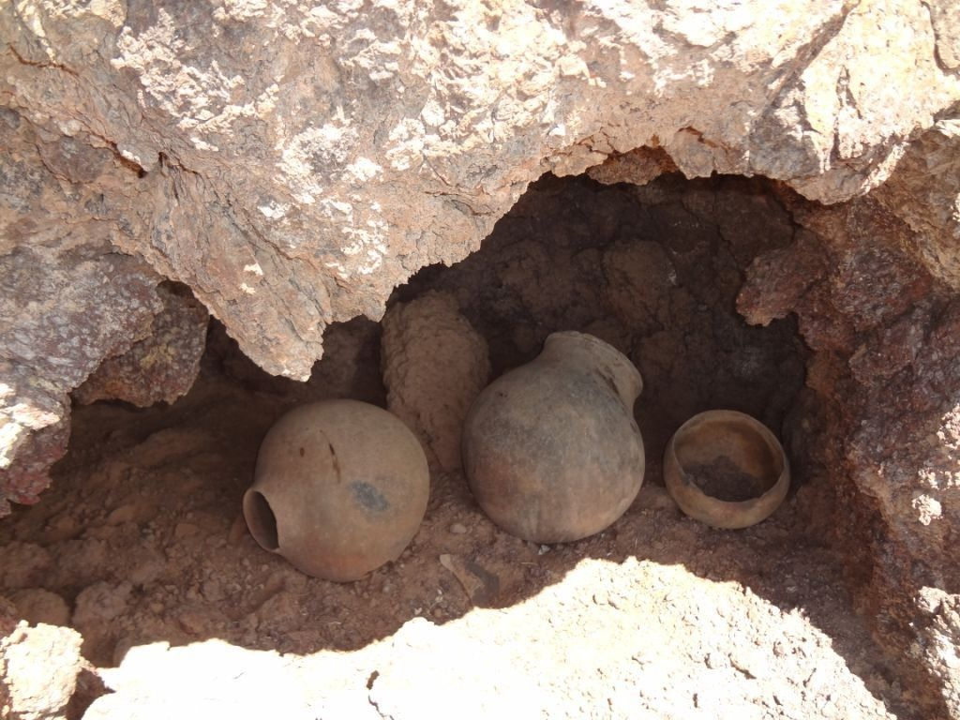

Slide 20
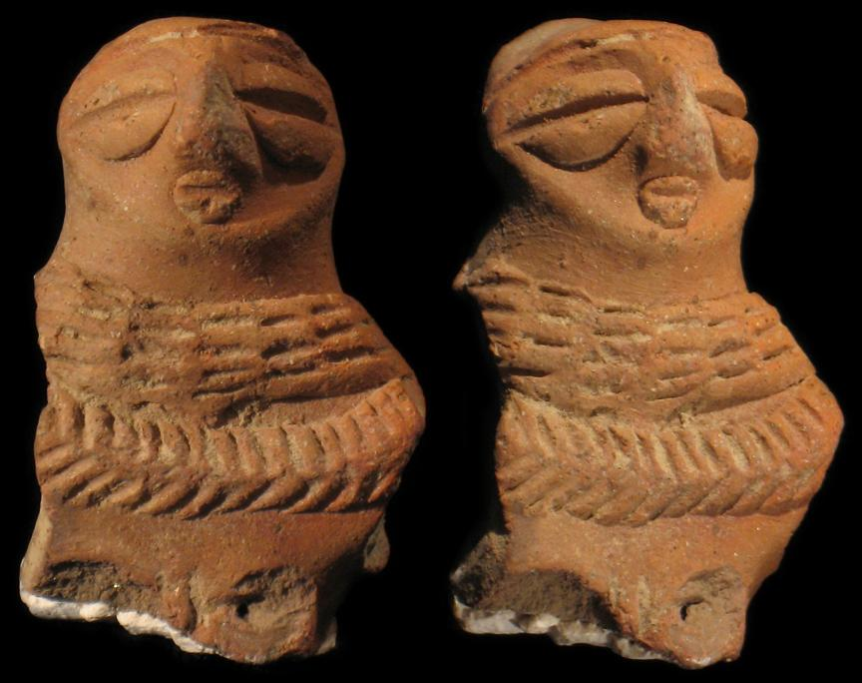

Slide 21
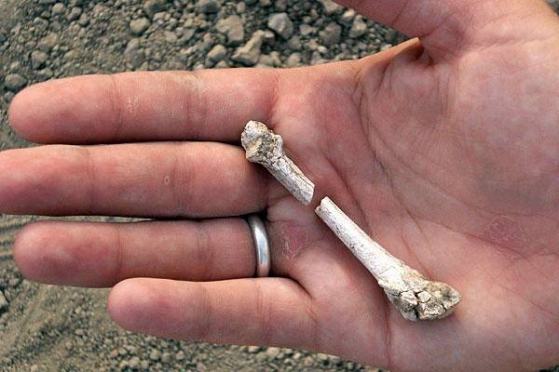

Slide 22
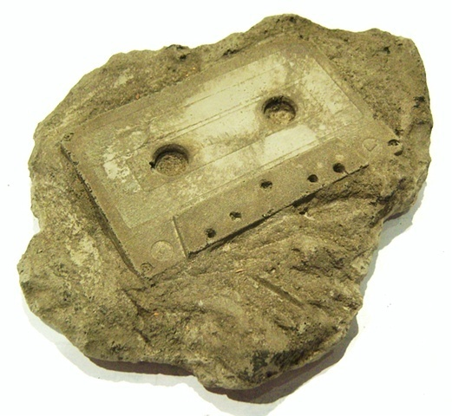

Slide 23
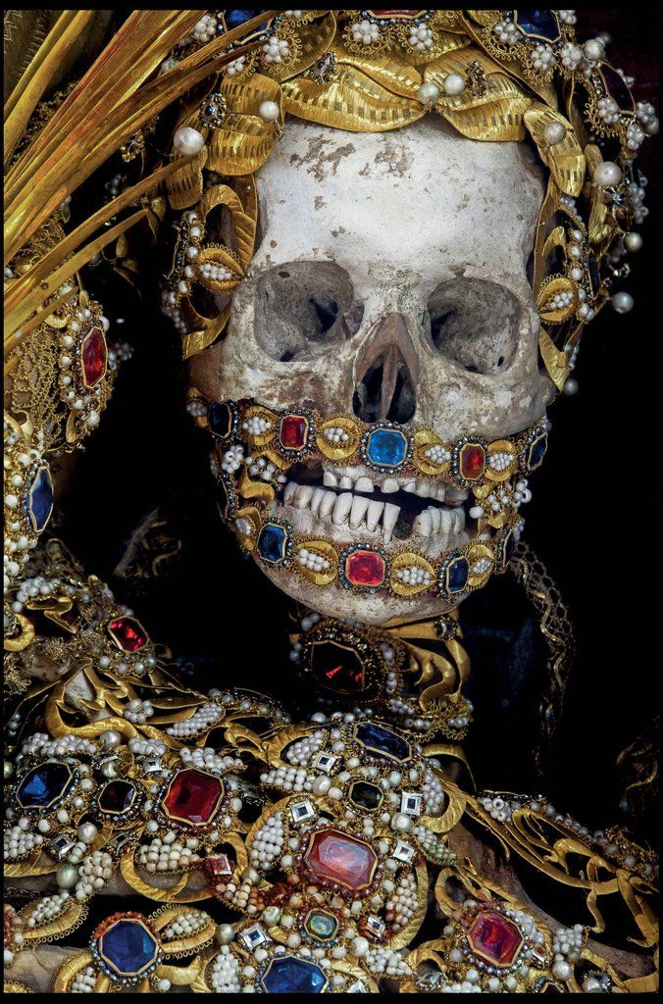
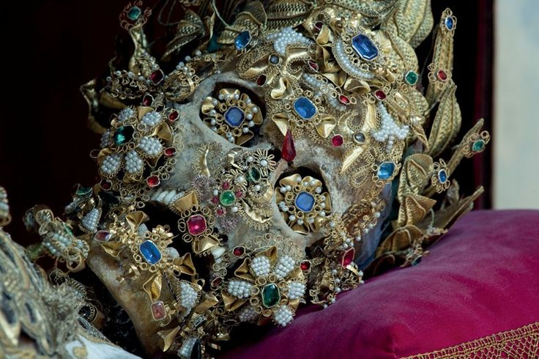

Slide 24
http://anthro.palomar.edu/culture/culture_1.htm
Human culture is learned…How would you explain this in your own words based on our reading?
Languages are cultures. is this statement true or false? why do you think so?
Do archeologists dig up culture in their excavations? What do these remains represent?
Culture is a powerful human tool for survival. According to our reading why is this a true statement?
How do cultures differ from societies? In what ways are they connected to each other?
Possible vocabulary hangups:
inextricably perceptions subculture cultural universals

Slide 25
Lesson #2 9.1.05: Students will Trace major themes in the development of the world from its origins to the rise of early civilizations 9.7.01: Students will assess the degree to which discoveries, innovations, and technologies have accelerated change. 9.8.03: Students will be able to classify within the broad patterns of history those events that may be viewed as turning points.

Slide 26
Agriculture
The science or practice of farming, including cultivation of the soil for the growing of crops and the rearing of animals

Slide 27
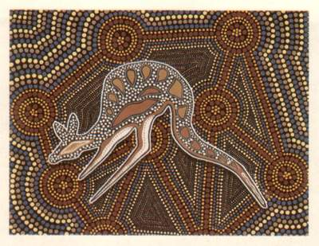
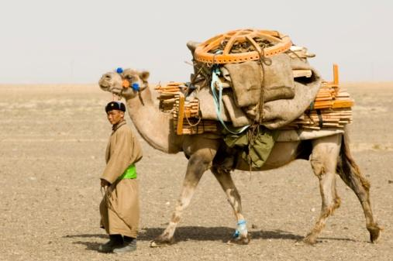
Nomadic
People without a permanent settlement, making their living by moving from place to place.
Animism
Belief that things in nature have a soul or consciousness.

Slide 28
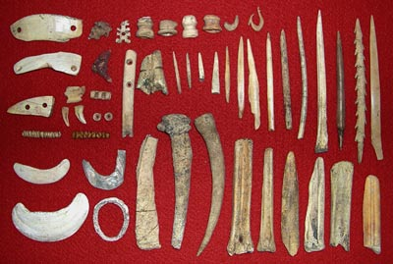
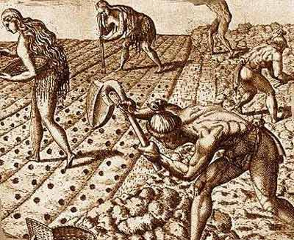
Paleolithic
“Old Stone Age”
~2 Million-10,000 B.C.E.
~Hominids use tools
#1 http://youtu.be/MYbDJF_gMtw
#2 http://youtu.be/-XD9ehC6MWo
Neolithic
“New Stone Age”
~10,000-3,200 B.C.E.
~The first farmers
http://youtu.be/IVHD9wGlbho

Slide 29
Paleolithic “Old Stone Age” (continued)
Burial of the dead
Belief in a spiritual world
Ability to travel over water in boats

Slide 30
Paleolithic “Old Stone Age”
Creation of stone, bone, and wood tools and weapons
Use of fire
Spoken language

Slide 31
Neolithic “New Stone Age”
Farming and domestication of plants and animals
Settling of permanent villages
Dominance of family, economic, and political life by men

Slide 32
Neolithic “New Stone Age” (Continued)
Gaining of prestige by warriors
Appearance of differences in wealth
Creation of first calendars
More elaborate tools and technologies

Slide 33
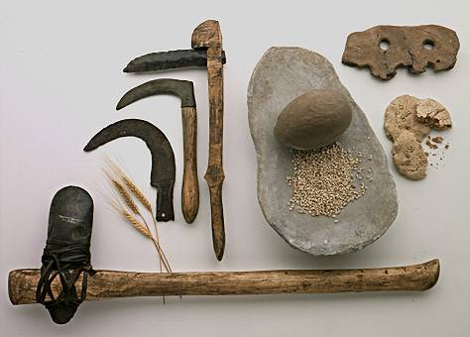
Tools

Slide 34
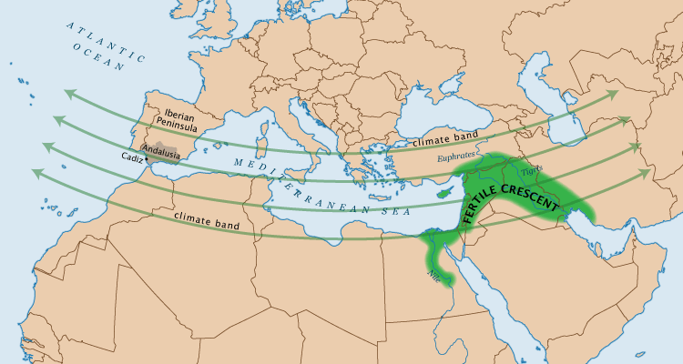

Slide 35
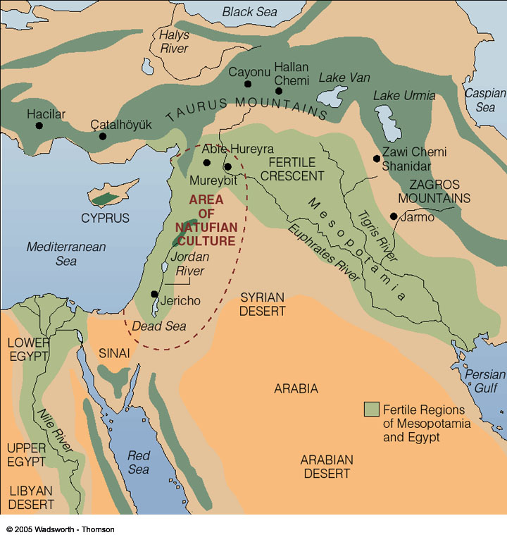

Slide 36
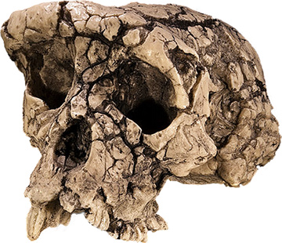
Sahelanthropus~6-7 Million Years ago
The name “Sahel” refers to the area of Africa where the fossils were found, while “anthropus” is based on a greek word meaning man.

Slide 37
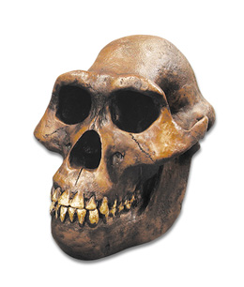
Australopithecines~3 million years ago
The name means “Southern ape” in relation to where the remains were discovered in central Chad in Africa.

Slide 38
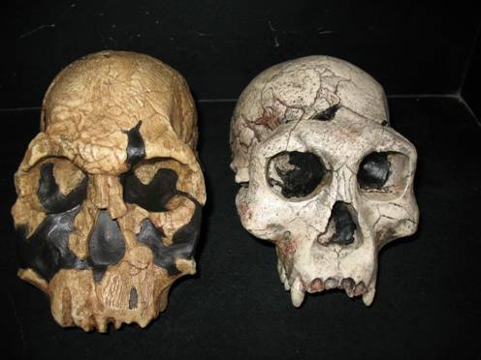
Homo habilis and Homo erectus fossils began turning up roughly around 2 Million Years ago.

Slide 39
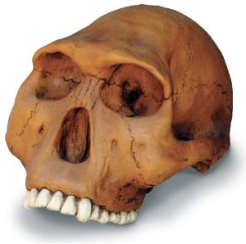
Homo habilis~2.3-1.5 Million years ago
Also known as the “handy man” because stone tools were found near its fossil remains. and it is assumed that this species had developed the ability to modify stone into tools.

Slide 40
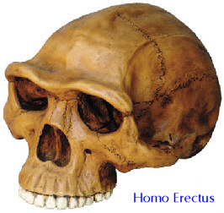
Homo erectus~1.8 million-100,000k
known as “upright man” this name was selected to indicate this species’ ability to stand and walk with an upright or erect stance.

Slide 41
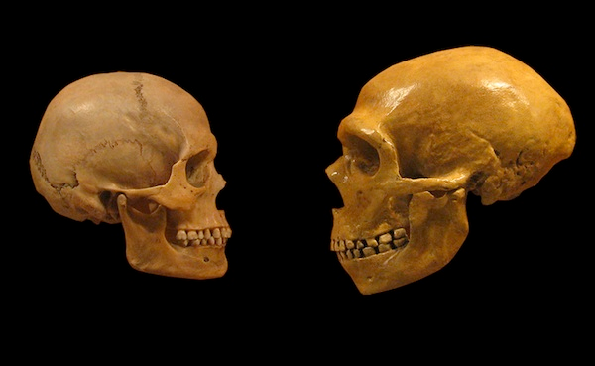
Homo sapiens and Homo neanderthalensis emerged together and coexisted for a long time in Europe and the Middle East ~300,000k years ago.

Slide 42
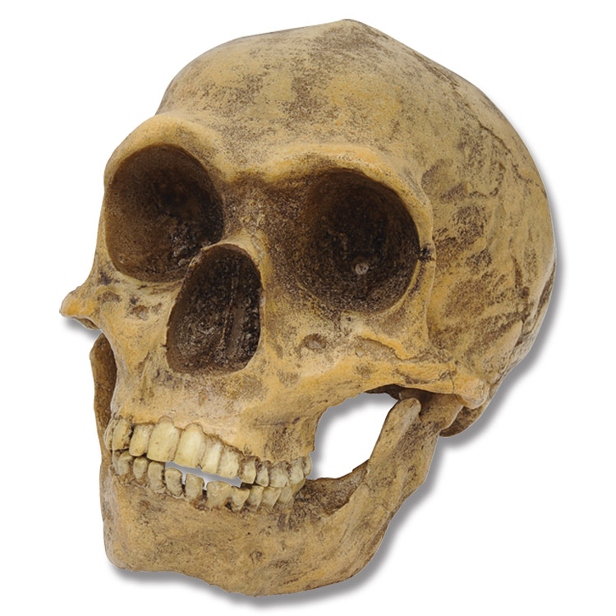
Homo neanderthalensis~300-28,000k years ago
Commonly known as neanderthals, this name was given based on the location where the first major specimen was discovered in the Neander Valley of Germany in 1856.

Slide 43
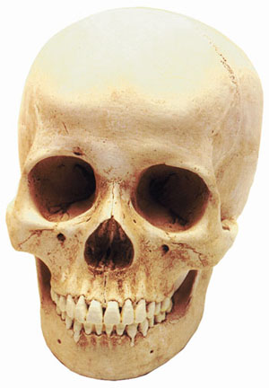
Homo sapiens~300,000k-present
The name we selected for ourselves means “wise human” sapiens being derived from a latin word meaning wise or astute.

Slide 44
Hominids
>Sahelanthropus
~6-7 Mill.Years ago
>Sahel is in Africa
>Anthropus~ Man
Australopithecines~3 mill years ago
> “Southern Ape”
>Homo Habilis
~2.3-1.5 Mill
years ago
> “Handy Man”
>Homo Erectus
~1.8 mill-100,000k
years ago
> “Upright Man”
>Neanderthals
~300-28,000 years
>Neander Valley Germany.
>Homo Sapiens
~300,000k-present
>”Wise Human”
https://www.youtube.com/watch?feature=player_detailpage&v=Mm-IxK1GrYE

Slide 45
Essential Elements of Narrative Essays
A narrative essay uses all the story elements
A beginning and ending, plot, characters, setting and climax.
All of these elements come together to complete the story.
The focus of a narrative essay is the plot, which is told using enough details to build to a climax.
Here's how:
It is usually told chronologically.
It usually has a purpose, which is usually stated in the opening sentence.
It may use dialogue.
It is written with sensory details and vivid descriptions to involve the reader. All these details relate in some way to the main point the writer is making.
All of these elements need to seamlessly combine.

Slide 46
More Tips on writing a narrative
Your words need to be vivid and colorful to help the reader feel the same feelings that you felt.
Elements of the story need to support the point you are making and you need to remember to make reference to that point in the first sentence.
You should make use of conflict and sequence.
You may use flashbacks and flash forwards to help the story build to a climax.
It is usually written in the first person, but third person may also be used.
Remember, a well-written narrative essay tells a story and makes a point. http://prezi.com/zprlee4ning3/?utm_campaign=share&utm_medium=copy&rc=ex0share

Slide 47
Homo Erectus
Homo Habilis
Homo Sapien
Homo Sahelanthropus
Homo Australopithecines
Homo Neanderthalensis

Slide 48
Citations
www.smithsonianmag.com
http://www.merriam-webster.com
https://www.khanacademy.org/
http://www.bradshawfoundation.com
http://australianmuseum.net.au/
http://notebookingfairy.com/pixiedust/all-purpose/timeline-notebooking-page.pdf
http://www.mesopotamia.co.uk/writing/story/sto_set.html
http://humanorigins.si.edu/evidence/human-evolution-timeline-interactive
http://commoncoresuccess.elschools.org/curriculum/grade-8/module-1/unit-1/lesson-6
#1 http://youtu.be/MYbDJF_gMtw
#2http://youtu.be/-XD9ehC6MWo
#3 http://youtu.be/PqHNQ9bvCfQ
http://www.besthistorysites.net/index.php/prehistory
Kill it eat it : http://youtu.be/3_MlaeUtkqU
Battle for earth http://youtu.be/TUliLKSJ4bQ
Neander pt 1 http://youtu.be/W7UFbxsF3p0

Slide 49
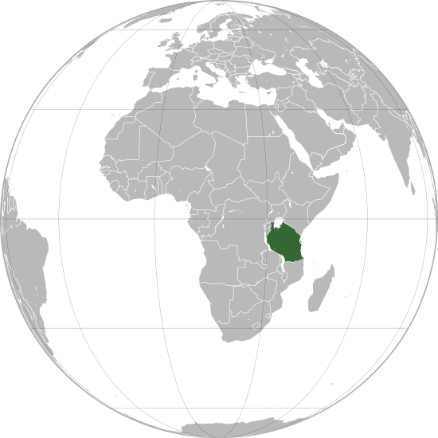
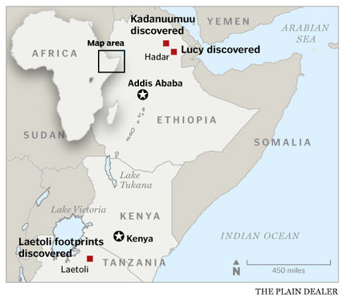
Tanzania Laetoli

Slide 50
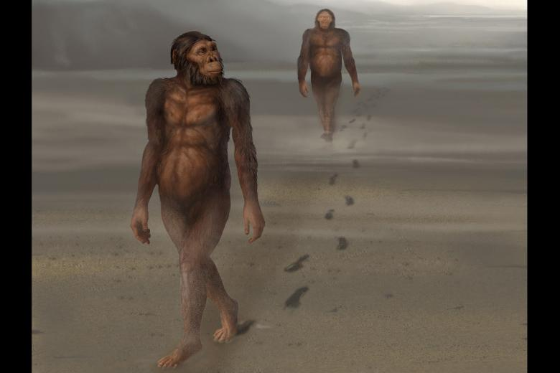
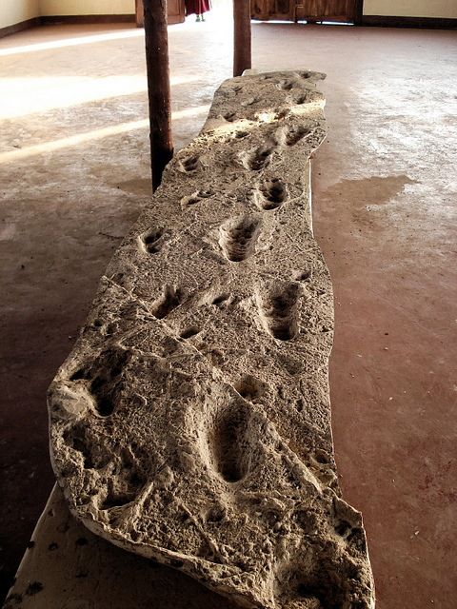
Laetoli Footprints found in Tanzania
3.6 Million Years ago.
https://www.youtube.com/watch?feature=player_detailpage&v=Mm-IxK1GrYE

